Slide 1
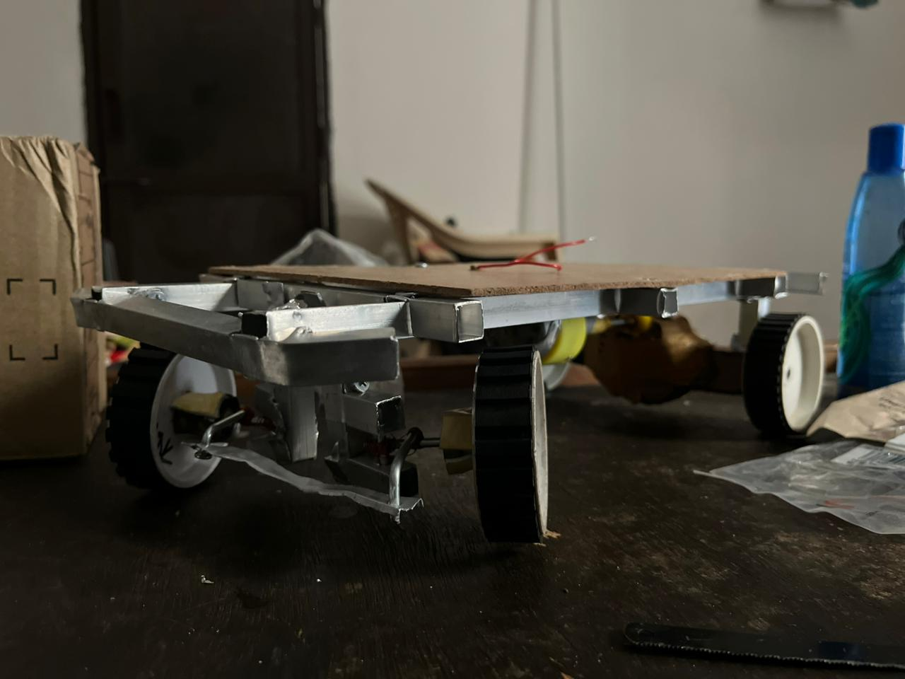
Smart Safety of Plug In Electrical Vehicle With Wireless charging
Electric mobility is transforming transportation, offering significant advantages in cost reduction, enhanced energy security, and minimized urban air pollution. This project introduces a versatile, cost-effective electric vehicle platform specifically designed for educational purposes and rapid prototyping.

Slide 2




Core Innovations: Efficiency, Safety & Modularity
Efficient Battery Pack
Small Gearbox
A high-density, modular battery system ensures reliable power and extended operational life.
Optimized for smooth power delivery and efficient torque conversion in a compact form factor.
ESP8266 Controls
Active Battery Safety
Embedded wireless controls for intelligent management and remote interaction.
Integrated safety mechanisms, including a unique battery ejection system, for paramount security.

Slide 3

System Architecture: A Unified Approach
Our EV platform integrates mechanical, electrical, and embedded modules into a cohesive, easily manageable system. This modular design emphasizes interchangeability and ease of maintenance, crucial for both educational settings and rapid prototyping.
Battery Ejection System
Modular Battery Pack
Rapid safe removal mechanism
Hot-swappable power module
Modularity and Easy Maintenance
ESP8266 Wireless Module
Compact Gearbox
Quick-remove mechanical unit
Remote diagnostics interface

Slide 4
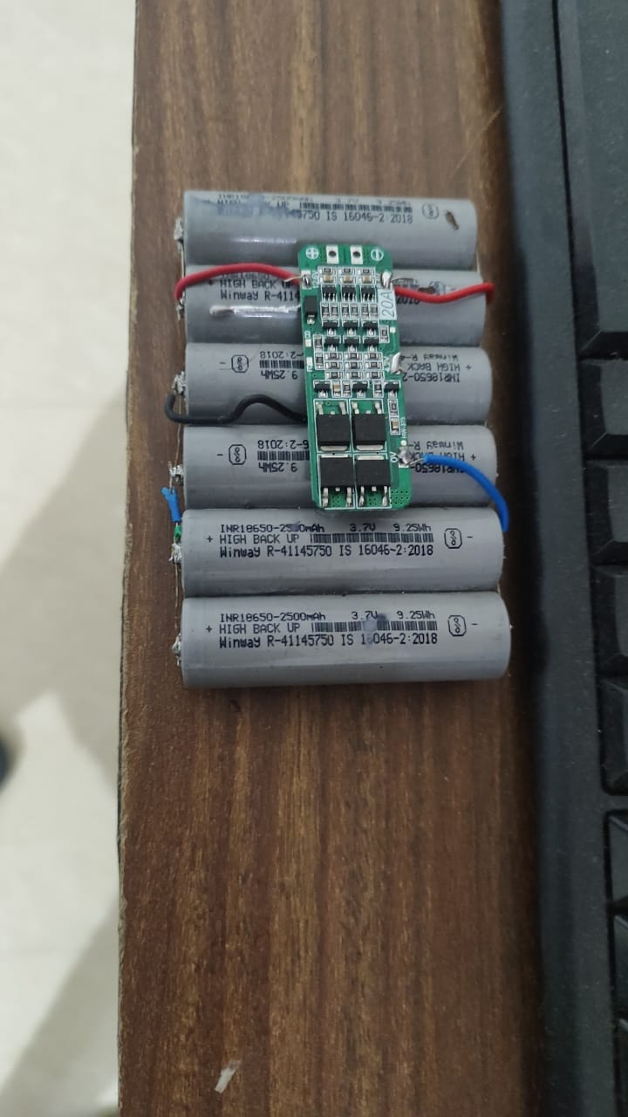
Advanced Battery Pack Design
The heart of our EV is an advanced battery pack, utilizing 3.7V lithium-ion cells configured as a 4S2P array to deliver 12V and 5A output. This configuration balances power and longevity. An advanced Battery Management System (BMS) rigorously monitors and controls the pack, ensuring safe and optimal performance.
Scalable: Easily expandable for diverse power requirements.
High Energy Density: Maximizes power in a compact size.
Efficient: Optimized for minimal energy loss during operation.
Long Life Cycle: Designed for durability and sustained performance.

Slide 5



Active Safety: Battery Protection & Ejection
Safety is paramount. Our system incorporates an active thermal management and ejection mechanism to prevent critical failures. An LM35 temperature sensor continuously monitors battery heat, while an ESP8266 microcontroller stands ready to act.
Temperature Monitoring
The LM35 sensor detects overheating, triggering immediate safety protocols.
ESP8266 Intervention
Upon fault detection, the microcontroller activates a servo-based system.
Automated Ejection
The battery pack is swiftly ejected, isolating the power source and preventing hazards, also enabling quick swaps.

Slide 6
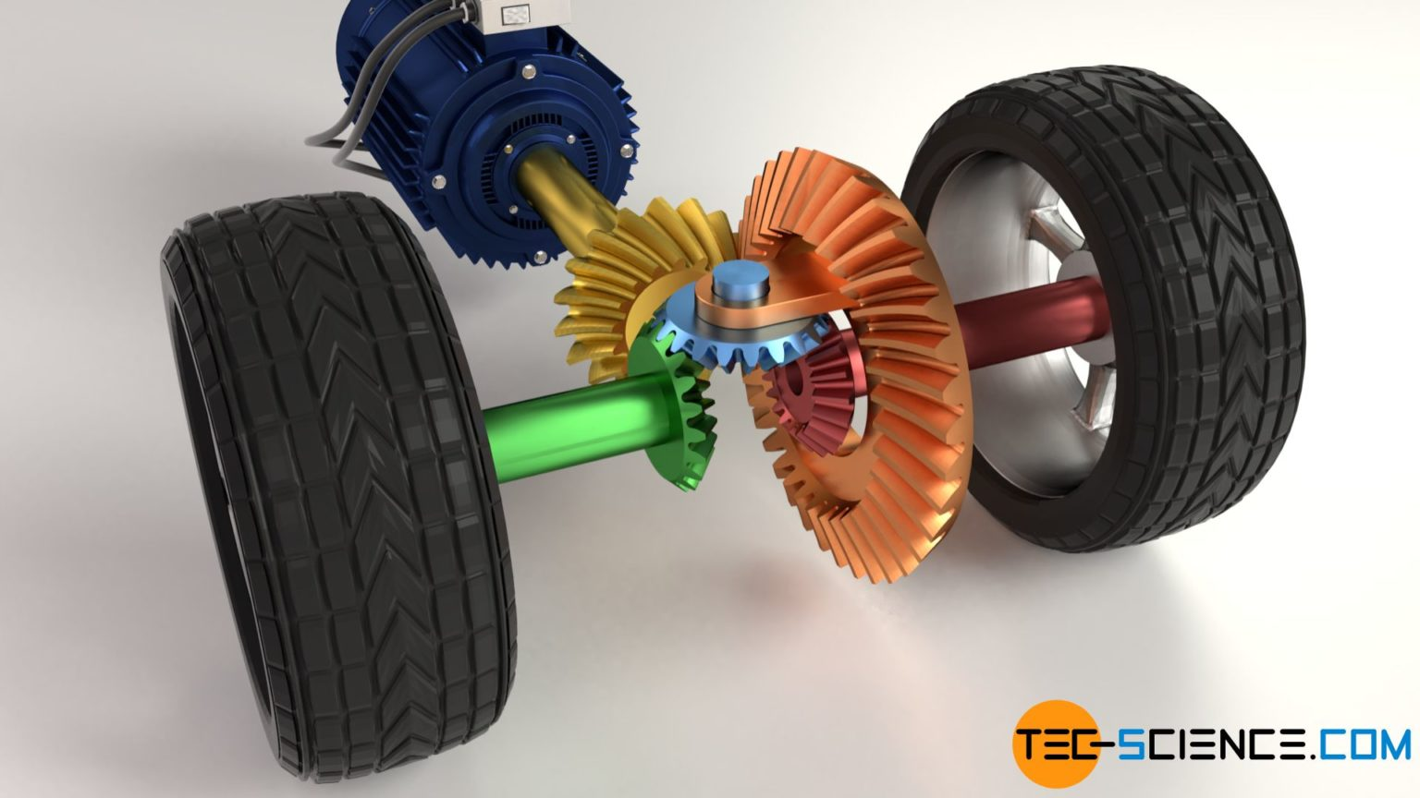
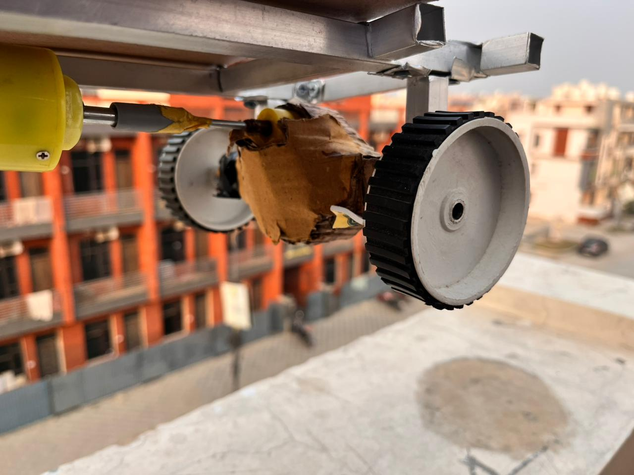
Precision Engineering:
Gear Mechanism Design
The compact gearbox is meticulously designed to modulate torque and speed, ensuring a smooth and responsive power transfer from the motor to the wheels. Gear ratios are carefully optimized for both initial launch torque and efficient cruising, providing a balanced performance profile.
Its modular design not only enhances serviceability but also allows for easy adaptation to different motor types or vehicle specifications, making it an ideal component for prototyping and iterative design.

Slide 7




Intelligent Control: Power Electronics & Remote System
The ESP8266 wireless module serves as the brain of the vehicle, managing critical functions from motor control to remote diagnostics. It facilitates real-time telemetry, fault alerts, and enables seamless wireless remote control, offering an intuitive user experience.
Motor Management
Telemetry & Alerts
Precise control over motor speed and direction.
Real-time data streaming and instant fault notifications.
Wireless Operation
Protection Circuits
Full remote control capabilities, enhancing usability and safety.
Safeguards against overcurrents and voltage spikes, ensuring system longevity.

Slide 8




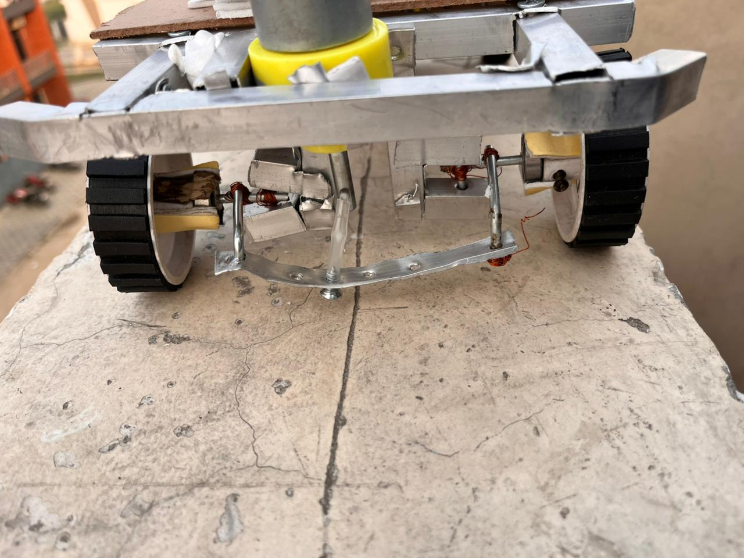
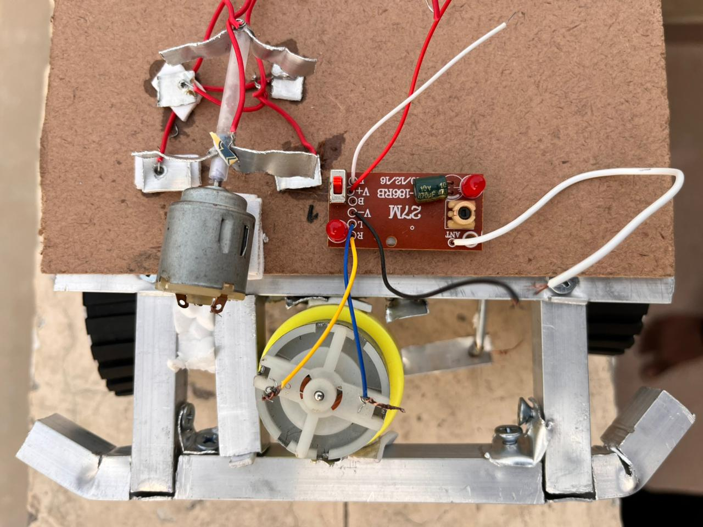




Integrated Vehicle Control System
The ESP8266 acts as the central controller, orchestrating all vehicle functions. It integrates sensor data, manages drive control, handles gear shifting, and implements robust fault management strategies. This holistic approach ensures optimal driving performance and enhanced safety.
Sensor Integration
Drive Control
Manages acceleration, braking, and steering inputs.
Aggregates data from various onboard sensors.
Gear Shifting
Fault Management
Identifies and responds to system errors, including battery isolation.
Automated or manual gear selection for efficient power delivery.

Slide 9
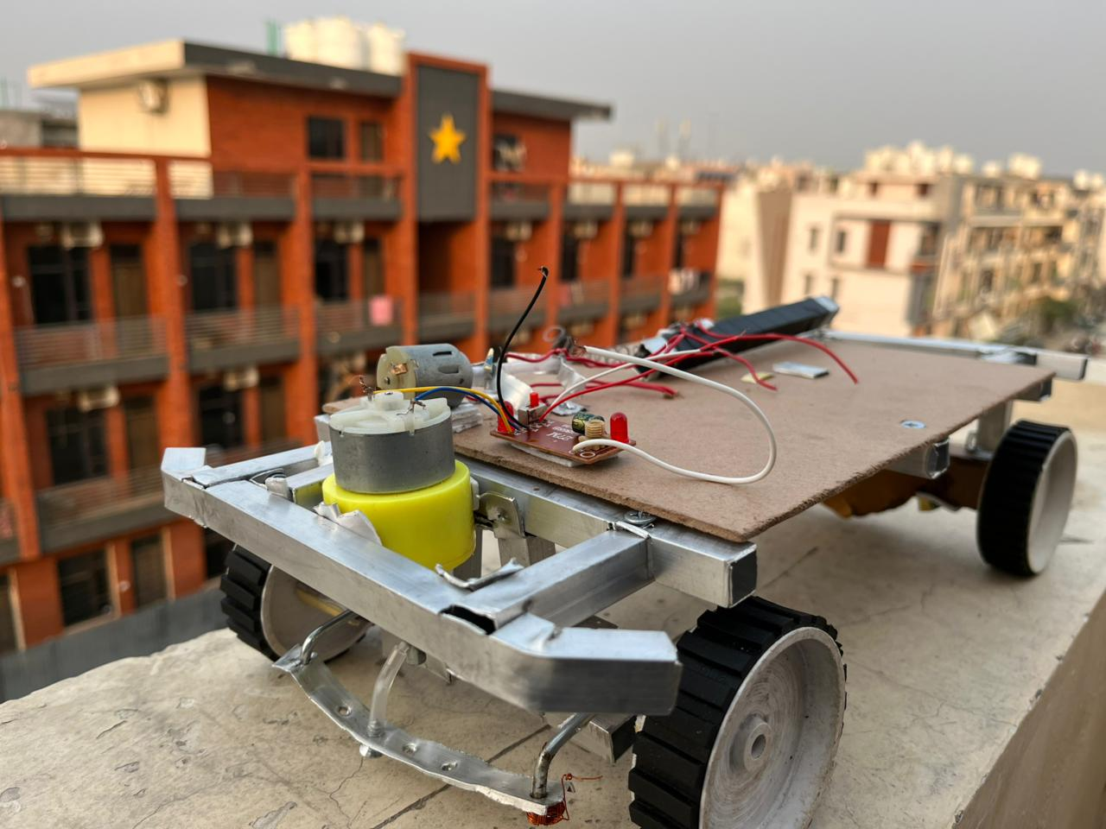
Connectivity & Communication: The ESP8266 Module
The ESP8266 module is pivotal for enabling comprehensive wireless capabilities. Its integrated Wi-Fi facilitates seamless remote control, efficient data transmission for performance analysis, and detailed telemetry.
Remote Actuation: Control the EV from a distance.
Diagnostics: Real-time system health checks and troubleshooting.
Over-the-Air Updates: Future-proofing with remote software enhancements.
Real-time Logging: Capturing critical operational data for analysis.

Slide 10
Validation, Economics & Future Horizons
Rigorous testing confirms the platform's stability, responsiveness, and safety features, including fault response and precise gear shifting. A comparative cost analysis highlights its competitive advantage against commercial EVs, underscoring its value for education and development.
Successful Validation
Confirmed stability, fault response, and precise control across all systems.
Cost-Effective Prototyping
Modular design drastically reduces development and maintenance costs.
Envisioning Growth
Future work includes advanced sensors, next-gen battery integration, IoT capabilities, and regenerative braking.
This platform stands as a testament to a successful, scalable, and serviceable EV design, paving the way for future innovations in electric mobility.

